Slide 1



Authentication Using Behavioral Biometrics
Jaypee University of Information Technology, Waknaghat - 173234 (India)
Major Project - I (18B19CI791) | AY 2024-25
Mid - Term Presentation
Group No. : 36
Team Member (s)
Akshit Sharma (211435)
Simran (211442)
Supervisor (s)
Name: Dr. Kushal Kanwar
Designation: Assistant Professor (SG)
Department: CSE & IT

Slide 2
Outline
Introduction
Problem Statement
Objectives
Literature Review
Project Design and Architecture
Tools, Technologies and Languages
Dataset
Implementation (if any)
Results (if any)
Key Learnings
Work Plan till End-Term Evaluation
Project Plan
Work Contribution of Each Member
Supervisor (s) Remarks
References

Slide 3
Introduction
Three key factors of authentication:
Something you know
Something you have
Something you are
Something you are : the way you behave / interact, that is, patterns in device usages
Base for our use : Sensor dynamics, touch strokes, keystroke patterns.
Our project aims to provide a seamless and non-intrusive form of second-factor authentication. It improves both usability and security. The project aims to authenticate a user, that is, know if the user is really him/herself, using their human behavioural traits, such as the way one holds their mobile phone.

Slide 4
Problem Statement
Data security by means of authentication is emerging as a very prevalent challenge in today’s world.
The need to balance usability and security is high, as by nature, we humans tend to avoid effort.
To achieve this, service providers must invest in a lot to analyse user patterns in their activity, which is not only resource heavy, but also opens a door for privacy breaches on the user side.
Our proposed solution is to use behavioral biometrics, a relatively underexplored field, in which we use behavioural data from the user, in this case, the way he/she handles his/her phone.

Slide 5
Objectives
To develop an application to gather a user’s natural behavioral information.
To develop and tailor a machine learning model to accurately identify a particular user.
To develop a prototype that implements the concept of the project.
The main objective of this project is to provide a seamless and continuous second factor of authentication to users as well as services. At this stage, we are focusing on serving the mobile applications that require this security, such as banking or online shopping services, employee portals, and even parental controls on niche applications.

Slide 6
Literature Review
S. No. | Author & Paper Title [Citation] | Journal/ Conference (Year) | Tools/ Techniques/ Dataset | Key Findings/ Results | Limitations/ Gaps Identified
1. | Yris, P., et al. Deep features fusion for user authentication based on human activity | IET Biometrics (2023) | UCI-HAR (consisting 30 subjects) | A new approach of signal-to-image transformation was introduced where time sensor data were converted into 2D images, enabling use of deep learning architectures. | The dataset was yet limited. Not considering gait would narrow down the accuracy of model based on only the way user would use smartphone device in a stationary position which is not very true to the nature.
2. | Praveen, R., et al. Continuous user authentication on smartphone via behavioral biometrics: a survey | Springer Nature 2022 Multimedia Tools and Applications (2023) | NA | Gives an idea over different datasets and features to be used. Reviews possible attacks on behavioral biometrics of the smartphones giving a direction to keep in check. | Theoretical approach of the concept with the deep practical knowledge yet to be tested.
3. | Stragapede, G., et al. Mobile behavioral biometrics for passive authentication. | Pattern Recognition Letters 157 - Elsevier (2022) | HuMIdb Database | Explored feasibility of unimodal and multimodal biometric traits Implemented these using recurrent neural networks (RNNs). | Considers touch stroke and magnetometer data as two separate databases for maximum accuracy but when we combine the values the model shows discriminative behaviors and accuracy drops
4. | Shihong, Z., et al. A Robust Continuous Authentication System Using Smartphone Sensors and Wasserstein Generative Adversarial Networks | Communication Security in Socialnet-Oriented Cyber Spaces (2021) | HOMG | Usage of WGANs (Wasserstein Generative Adverbial Networks). Providing comparison among the classifiers used to test deep features giving insight of what algorithm to use and focus on. | Lack of real-world testing makes it limited for the usage. Especially not being able to extensively consider challenges like sensor noise or unpredictable user behaviors in daily life. Also, Only a limited set of user activity has been traced.

Slide 7
Literature Review (cont…)
S. No. | Author & Paper Title [Citation] | Journal/ Conference (Year) | Tools/ Techniques/ Dataset | Key Findings/ Results | Limitations/ Gaps Identified
5. | Lavanya, B., et al. Impact of Behavioral Biometrics on Mobile Banking System | Journal of Physics: Conference Series, Volume 1964, Advances in Computational Electronics and Communication Engineering (2021) | NA | Provided a better overview of the types of attack and how this can be used in the banking sector | Centrally worked only around biometrics such as eye movement and fingerprints hand geometry etc.
6. | Jianfeng, G., et al. Design and Implementation of Continuous Authentication Mechanism Based on Multimodal Fusion Mechanism | Communication Security in Socialnet-Oriented Cyber Spaces (2021) | 15000 mouse operations | Proposed MFCA system for behavior collections. Also provided with the exact features to look into when applying the classification model. | Limited behavior types, major focus was only on keystroke, mouse movement and application usage.
7. | Ioannis, S., et al. Behavioral biometrics & continuous user authentication on mobile devices: A survey | Information Fusion (2021) | NA | Gave a background and information regarding sensors. Provided with the current challenges and the machine learning algorithms used and their limitations. | A more theoretical approach than a practical one.
8. | Abuhamad, M., et al. Sensor-based continuous authentication of smartphones’ users using behavioral biometrics: A contemporary survey. | IEEE Internet of Things Journal (2021) | NA | Explored motion based, gait based, keystroke dynamic based and touch based methods. Sensor and orientation of a device held by a user also one of the methods. | A survey paper that put into account major works done in the field and the future aspects instead of providing with any new approach.

Slide 8
Literature Review (cont…)
S. No. | Author & Paper Title [Citation] | Journal/ Conference (Year) | Tools/ Techniques/ Dataset | Key Findings/ Results | Limitations/ Gaps Identified
9. | Alsaadi, I. Study on most popular behavioral biometrics, advantages, disadvantages and recent applications. | International Journal of Scientific & Technology Research (2021) | NA | Goes into details regarding different behavioral biometrics techniques, including voice recognition, gait recognition and keystroke dynamics. | A theoretical approach over the concept of behavioral biometrics, giving in detail over them rather than providing a practical approach.
10. | Alzubaidi, A., & Kalita, J. Authentication of smartphone users using behavioral biometrics. | IEEE Communications Surveys & Tutorials (2016) | NA | Aimed to study the existing studies and approaches in the field of behavioral biometrics and different types of behavioral authentication, like hand waving, keystroke dynamics, etc | More of a review paper so instead of learning a new methodology it was a survey of other research papers so do not provide us with an innovation in the technology.
11. | Buriro, A., et al. Touchstroke: Smartphone user authentication based on touch-typing biometrics. | Springer International (2015) | 12 Subjects 30 Patterns 2160 Samples | Presents a new behaviour-based authentication scheme called Touch stroke, which takes into account two human behaviours : how the phone is held and how a user enters a 4-digit PIN | Limited number of users makes it difficult to provide data based on general population and hence there is a bias of the users as they claimed.
12. | Zheng, N., et al. You are how you touch: User verification on smartphones via tapping behaviors. | IEEE (2014) | 80 Subjects 25 times per subject | Proposed a mechanism called non-intrusive user verification. The authors studied behavioral authentication by analysing the way a user touches the phone. | Took into account multiple sensors but did not consider that a user's own behaviors can change over time due to multiple factors like injury stress etc.

Slide 9
Literature Review (cont…)
S. No. | Author & Paper Title [Citation] | Journal/ Conference (Year) | Tools/ Techniques/ Dataset | Key Findings/ Results | Limitations/ Gaps Identified
13. | Li, L., Zhao, X., & Xue, G. Unobservable re-authentication for smartphones. | IEEE (2013) | 75 Subjects | Analyzes and learns user finger movement patterns, running in the background to monitor and compare these movements to the owner's patterns for continuous verification without user intervention. | Even though there was a higher accuracy in their first testing database but then they realized that for a higher dataset the accuracy was reaching to a threshold with increasing size.
14. | Zhao, X., et al. Continuous mobile authentication using a novel graphic touch gesture feature. | IEEE (2013) | 30 Subjects 300 Touch Gestures | Utilizes Android's standard API to capture and observe touch gestures. Upon screen contact by users, it records traces as raw touch samples. | Limited size of data and the users only perfumed 6 most commonly used touch gestures over a long period of time hence there was a lack of consideration of outlier. And the device used was also the same.
15. | De Luca, A., et al. Touch me once and I know it's you! Implicit authentication based on touch screen patterns. | ACM (2012) | 26 Subjects (Lab Test) 645 valid authentications 2790 Attacks | Conducted two studies: a short-term lab study focused on basic security techniques, like using a stroke, and a long-term study that employed password patterns with passive authentication. | Lack of attackers for some of the participants is undesirable since the data collected was lab tests and it was basically entering the pattern, so it does lack the main purpose which was to provide continuous authentication.
16. | Saevanee, H., & Bhattarakosol, P. Authenticating user using keystroke dynamics and finger pressure. | IEEE (2009) | 10 Subjects 3000 values of finger pressure | Implemented a method, which detects and recognizes users in terms of hold-time, inter-key and finger pressure. This used both keystroke and touchscreen patterns. | Not a very good approach since the results rejected legitimate users with high probability and led to constant ere-authentication of the user.

Slide 10
Literature Review (cont…)
S. No. | Author & Paper Title [Citation] | Journal/ Conference (Year) | Tools/ Techniques/ Dataset | Key Findings/ Results | Limitations/ Gaps Identified
17.
18.
19.
20.

Slide 11
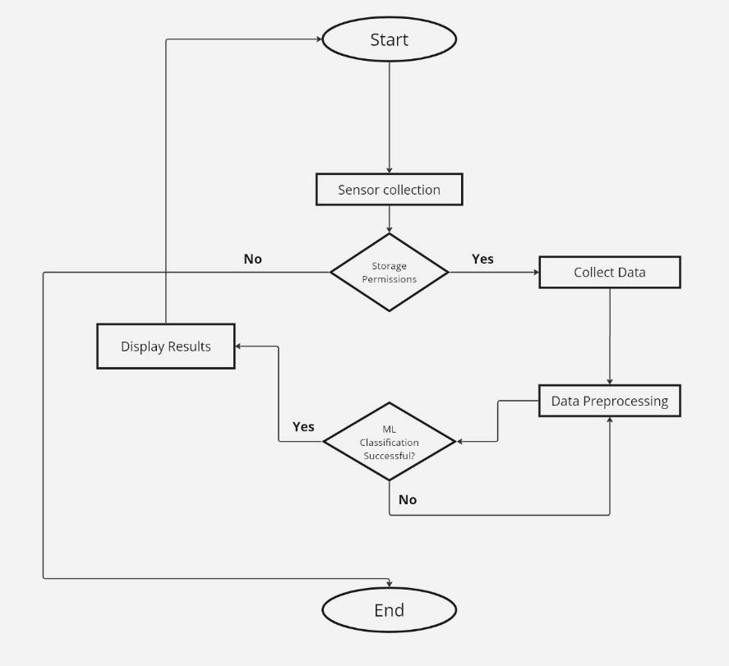
Project Design and Architecture
Flow graph of the project problem

Slide 12
Project Design and Architecture (cont…)
Start: The process begins.
Sensor Collection: The system checks if the required sensors are enabled and permissions are granted.
If No, it skips to displaying results.
If Yes, it proceeds to collect data from the sensors.
Data Collection & Preprocessing: The collected data undergoes preprocessing to make it suitable for machine learning.
ML Classification: The preprocessed data is evaluated using machine learning for classification.
If classification is successful, results are displayed.
If unsuccessful, it loops back for further processing.
End: The process ends.

Slide 13
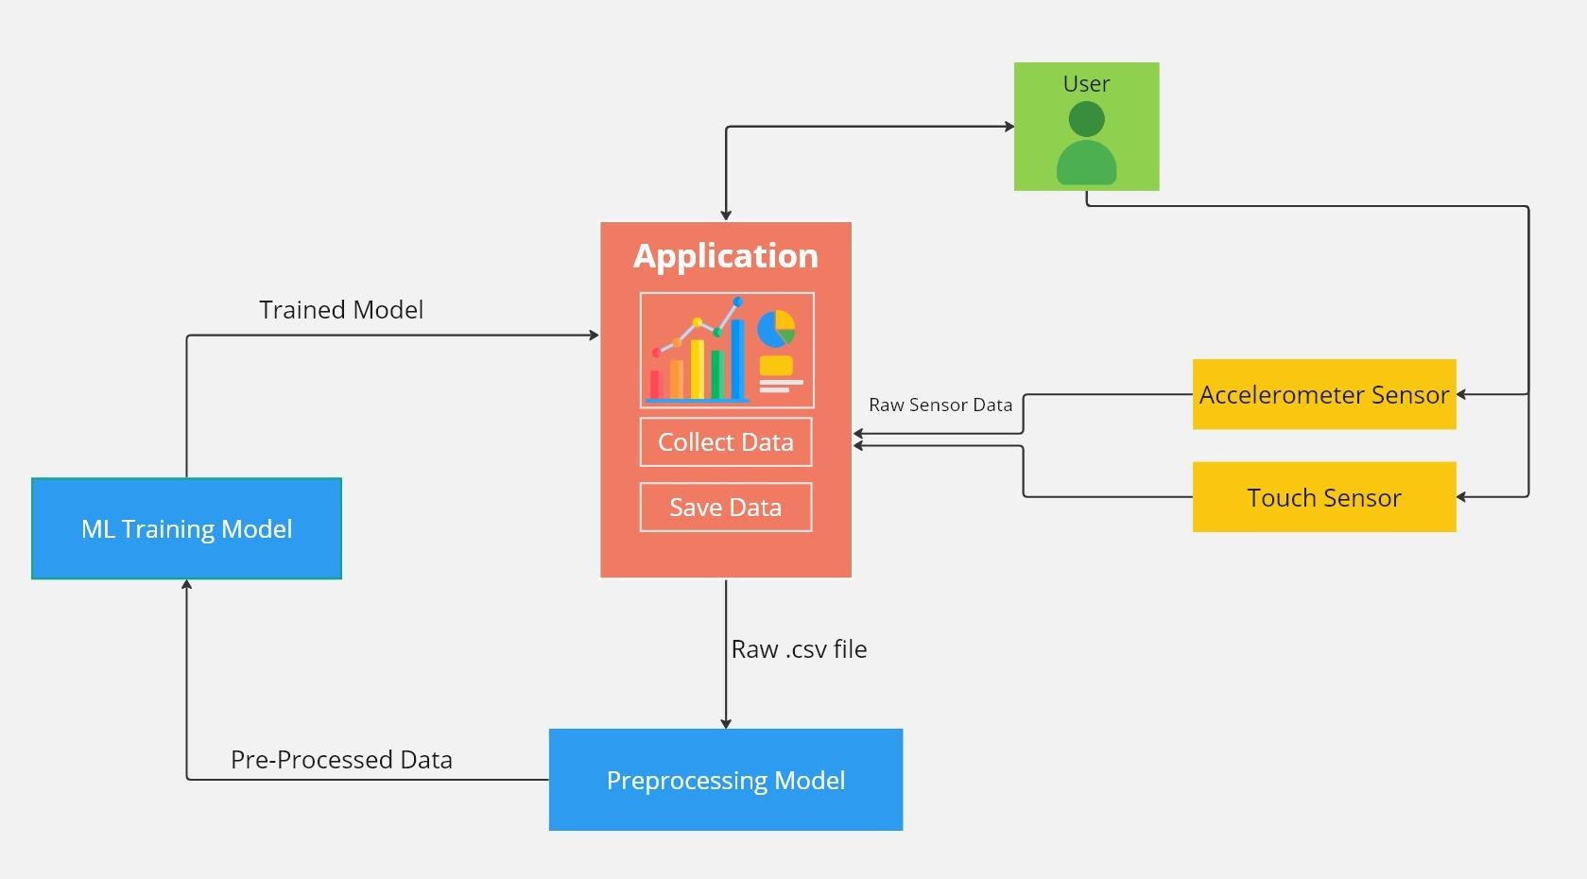
Project Design and Architecture
Data Flow Diagram (DFD)

Slide 14
Project Design and Architecture (cont…)
User Interaction: The user interacts with two types of sensors:
Accelerometer Sensor: Captures motion-based data from the user.
Touch Sensor: Captures touch-based input from the user.
Application:
Collect Data: The application gathers raw sensor data from the sensors.
Save Data: The collected data is saved as a raw .csv file.
Preprocessing Model: The raw .csv file is passed to the Preprocessing Model to clean and organize the data. This outputs pre-processed data that is more suitable for machine learning.
ML Training Model: The pre-processed data is fed into the ML training model. This model learns from the data to create a Trained Model.
Trained Model: The trained model is returned to the application for use in tasks like predictions or further processing.

Slide 15
Tools, Technologies and Languages
Tools and Platforms
Firebase : For authentication management and cloud storage.
Flutter : Mobile app development framework.
Android Studio : Integrated Development Environment (IDE) for testing and deployment.
GitHub : Version control and collaboration platform.
Technologies
Machine Learning : Behavioral data analysis to identify unique patterns.
Cloud Computing : Scalable storage and processing via Firebase.
Mobile Sensors : Leverages accelerometer, gyroscope, and touch sensors.

Slide 16
Tools, Technologies and Languages (cont…)
Programming Languages
Dart : Primary language for app development with Flutter.
Python : For implementing machine learning models and algorithms.
JavaScript : Used in backend operations and Firebase integration.

Slide 17
Dataset
Currently, the dataset, which combines .csv files from different test subjects, has the following parameters:
Timestamp
Accelerometer (x – axis)
Accelerometer (y – axis)
Accelerometer (z – axis)
Last Touch (x)
Last Touch (y)
Overall, there are more than 1,97,900 entries in the dataset collected from 9 people. These are labelled according to their respective person to which the data belongs.

Slide 18
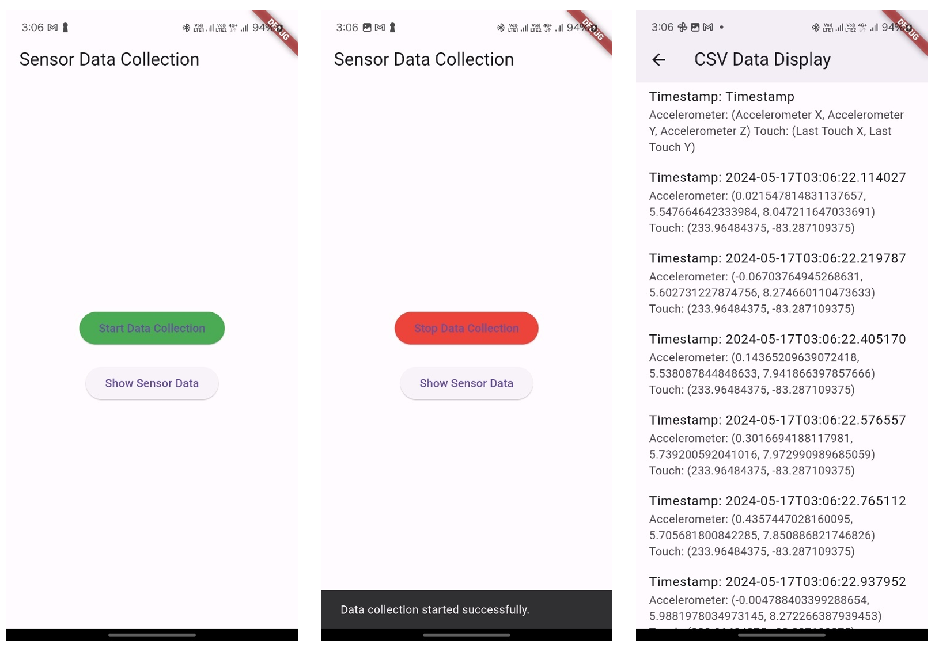
Implementation (if any)
Currently, we are working on implementing the mobile app for collection of data.
The current implementation allows us to collect a user’s data manually, but the current drawbacks are:
Lack of background data collection support
Users have to manually send the .csv file.
Only the accelerometer and last touch data is available for now.

Slide 19
Results (if any)

Slide 20
Key Learnings
Understanding of Behavioral Biometrics by reading more research papers.
Learned the process of collecting sensor data, particularly from accelerometers and touch inputs, and how to organize it into usable formats like .csv files.
Faced challenges with background data collection and user involvement in sending data, which highlighted areas for further automation.

Slide 21
Work Plan till End-Term Evaluation
Till the end term evaluation, we aim to:
Work on the data collection application to automate data collection, as well as to run it in the background in order to get more natural data.
Incorporate more sensors in the data collected.
Get the basic understanding of machine learning & its various approaches.
Read more research papers to get a better understanding of the subject matter.

Slide 22
Project Plan
Activity | Year 2024 |  |  |  |  |  |  |  |  |  | Year 2025
 | Aug. |  | Sept. |  | Oct. |  | Nov. |  | Dec. |  | Jan. |  | Feb. |  | Mar. |  | Apr. |  | May
Literature Review
Analysis and Requirements
Project Design and Architecture
Implementation: Data Collection App
Implementation: ML Model
Testing, Validation & Prototyping
Documentation and Write-up

Slide 23
Work Contribution of Each Member
S. No. | Roll No. | Work Done | Work Contribution (%)
1. | 211435 | Read research papers regarding the topic. Researched & Implemented background run for data collection app. Currently automating the data collection from the app. | 50%
2. | 211442 | Read research papers regarding the topic. Researched behaviors that can be used for biometrics. Implemented additional data points in the app. | 50%

Slide 24
Supervisor Remarks
S. No. | Week No. & Date (dd/mm/yy) | Remarks (as mentioned in the weekly log) | Incorporated (Yes/No)
1. | 1 (26/08/2024) | OK | Yes
2. | 2 (02/09/2024) | OK | Yes
3. | 3 (10/09/2024) | OK | Yes
4. | 4 (16/09/2024) | OK | Yes
5. | 5 (21/09/2024) | OK | Yes
6. | 6 (27/09/2024) | OK | Yes

Slide 25
References
P. Yris, et al., "Deep features fusion for user authentication based on human activity," IET Biometrics, vol. 12, no. 1, pp. 45-57, 2023.
R. Praveen, et al., "Continuous user authentication on smartphone via behavioral biometrics: a survey," Multimedia Tools and Applications, Springer, 2023.
G. Stragapede, et al., "Mobile behavioral biometrics for passive authentication," Pattern Recognition Letters, vol. 157, pp. 130-140, 2022.
Z. Shihong, et al., "A Robust Continuous Authentication System Using Smartphone Sensors and Wasserstein Generative Adversarial Networks," Communication Security in Socialnet-Oriented Cyber Spaces, 2021.
B. Lavanya, et al., "Impact of Behavioral Biometrics on Mobile Banking System," Journal of Physics: Conference Series, Advances in Computational Electronics and Communication Engineering, vol. 1964, 2021.
G. Jianfeng, et al., "Design and Implementation of Continuous Authentication Mechanism Based on Multimodal Fusion Mechanism," Communication Security in Socialnet-Oriented Cyber Spaces, 2021.
S. Ioannis, et al., "Behavioral biometrics & continuous user authentication on mobile devices: A survey," Information Fusion, 2021.

Slide 26
References (cont…)
M. Abuhamad, et al., "Sensor-based continuous authentication of smartphones’ users using behavioral biometrics: A contemporary survey," IEEE Internet of Things Journal, 2021.
I. Alsaadi, "Study on most popular behavioral biometrics, advantages, disadvantages and recent applications," International Journal of Scientific & Technology Research, vol. 10, no. 12, pp. 320-326, 2021.
A. Alzubaidi and J. Kalita, "Authentication of smartphone users using behavioral biometrics," IEEE Communications Surveys & Tutorials, vol. 18, no. 3, pp. 1998-2026, 2016.
A. Buriro, B. Crispo, F. Del Frari, and K. Wrona, "Touchstroke: Smartphone user authentication based on touch-typing biometrics," Springer International Publishing, 2015.
N. Zheng, K. Bai, H. Huang, and H. Wang, "You are how you touch: User verification on smartphones via tapping behaviors," IEEE, 2014.
H. Saevanee and P. Bhattarakosol, "Authenticating user using keystroke dynamics and finger pressure," IEEE Proceedings of the International Conference on Computing and Convergence Technology, 2009.
L. Li, X. Zhao, and G. Xue, "Unobservable re-authentication for smartphones," IEEE Transactions on Mobile Computing, vol. 12, no. 2, pp. 1-10, 2013.

Slide 27
References (cont…)
X. Zhao, T. Feng, and W. Shi, "Continuous mobile authentication using a novel graphic touch gesture feature," IEEE Transactions on Mobile Computing, vol. 12, no. 9, pp. 1-15, 2013.
A. De Luca, A. Hang, F. Brudy, C. Lindner, and H. Hussmann, "Touch me once and I know it's you! Implicit authentication based on touch screen patterns," in Proceedings of the ACM Conference on Human-Computer Interaction with Mobile Devices and Services (MobileHCI), 2012.

Slide 28
Thanks.

